Slide 1
Learning from Imperfect Data: Transfer Learning, Weakly Supervised Learning, and Curriculum Learning for Image Understanding and Super-Resolution
Weifeng Ge
Department of Computer Science
The University of Hong Kong

Slide 2
About Me
丨Research Interests
Pattern Recognition and Machine Learning: Large Scale Deep Learning, Sequential Signal Processing, Deep Transfer Learning, Deep Metric Learning, Weakly Supervised Learning, Generative Models
Computer Vision: Face Recognition, Object Recognition, Object Detection, Semantic Segmentation, Image Retrieval, Image Super Resolution
丨Education
The University of Hong Kong, Hong Kong July, 2015 – present
Ph.D student in computer science
Tsinghua University, P.R. China Aug, 2012 – July, 2015
M.S. in Electronic Engineering
Huazhong University of Science and Technology, P.R. China Sep, 2008 – June, 2012
B.S. in Optical Electronic Science and Technology

Slide 3
Outline
丨Transfer Learning for Image Recognition
- Classification with Insufficient Training Data (CVPR 2017)
丨Weakly Supervised Image Understanding
- Multi-label Classification (CVPR 2018)
- Object Detection
Semantic Segmentation
丨Image Super-resolution
- Deterministic-Stochastic Modeling (SIGGRAPH Asia 2018)
- Local Statistical Rectification

Slide 4
Borrowing Treasures from the Wealthy: Deep Transfer Learning through Selective Joint Fine-Tuning
Weifeng Ge Yizhou Yu
The University of Hong Kong
https://github.com/ZYYSzj/Selective-Joint-Fine-tuning

Slide 5
Introduction
The Overfitting Problem of Deep Neural Networks
DNNs require a large amount of training data while preparing so much data might be infeasible in many cases.
Feature Extraction and Fine-Tuning
Off-the-shelf CNN features have been proven to be powerful in a variety of computer vision problems. Knowledge learnt from ImageNet / Places / MS COCO can be generalized to other applications.
[Sharif Razavian et al. 2014], [Donahue et al. 2014]

Slide 6




Observations
Additional images sharing similar characteristics with an existing training set could strengthen the kernels in convolutional layers.
Searching for additional images using low-level characteristics has less restrictions， and can collect more training data than using high-level semantic contents
Source Domain Data $𝒟_{s}$
Source Learning Task $𝒯_{s}$
Knowledge Sharing and Adaptation !
Target Domain Data $𝒟_{t}$
Target Learning Task $𝒯_{t}$
Multi-task Learning Pipeline

Slide 7
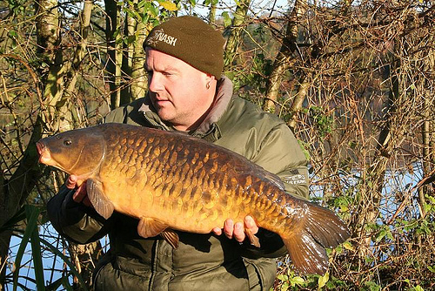
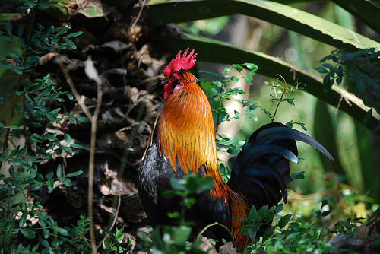
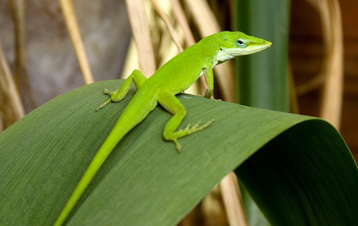
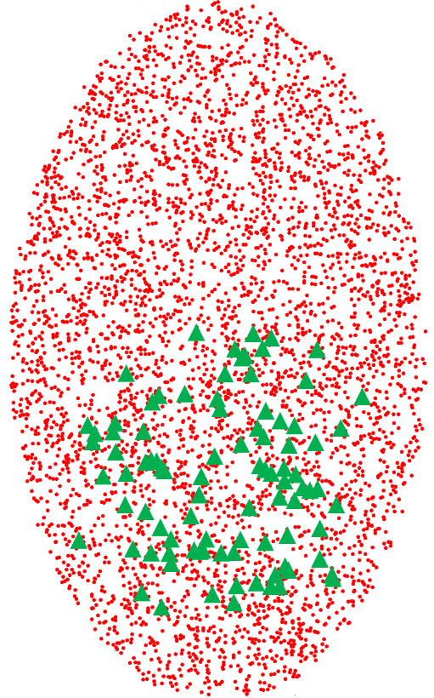
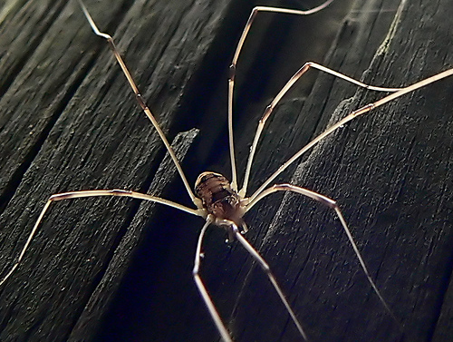
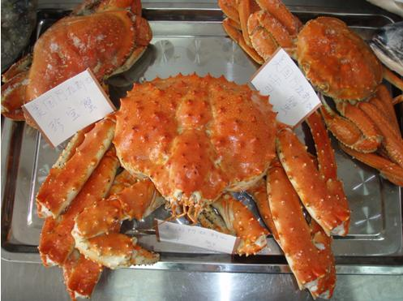
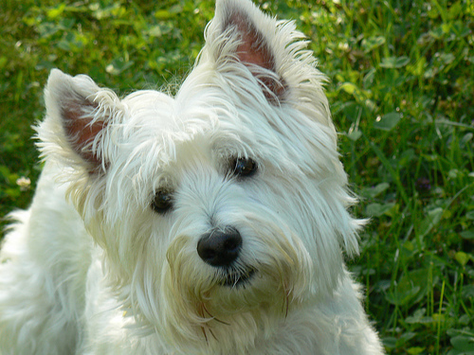

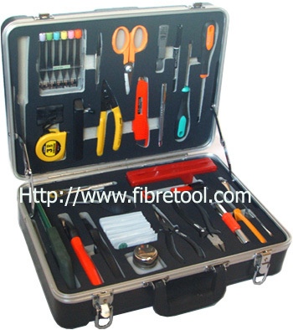
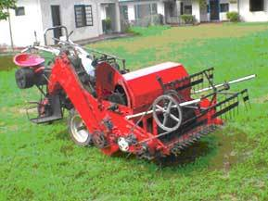
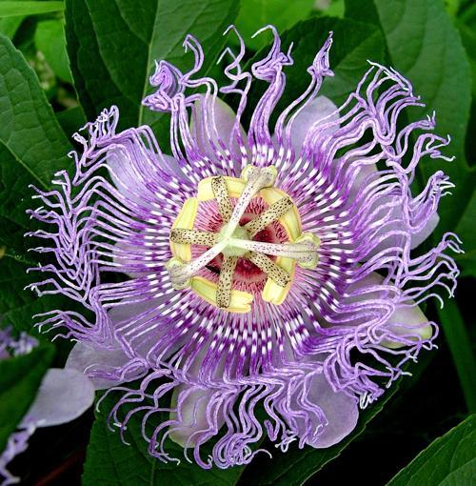
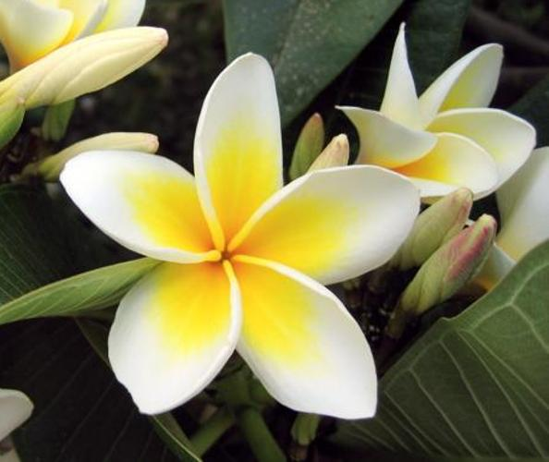
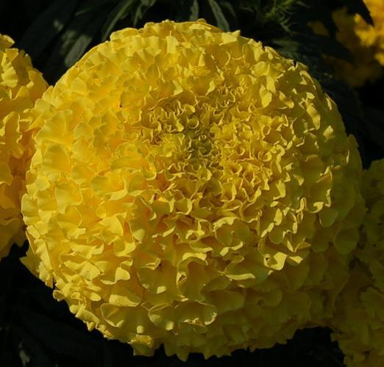

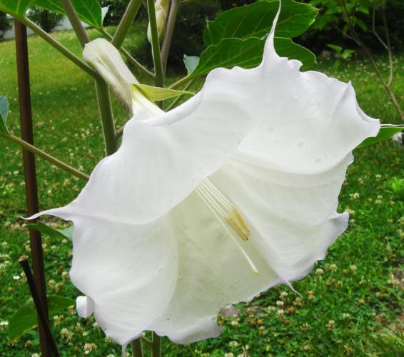
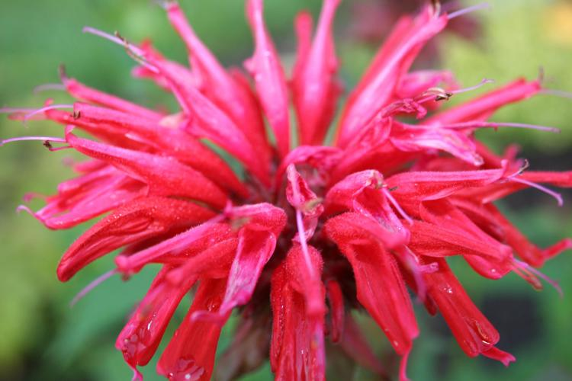
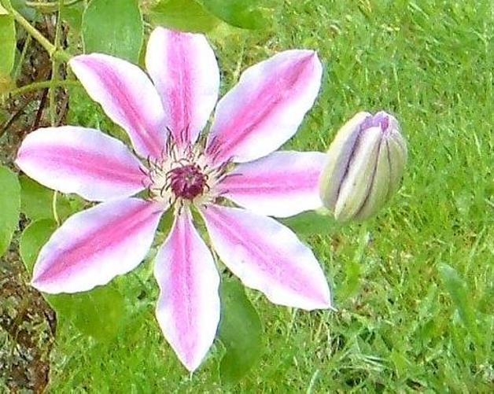
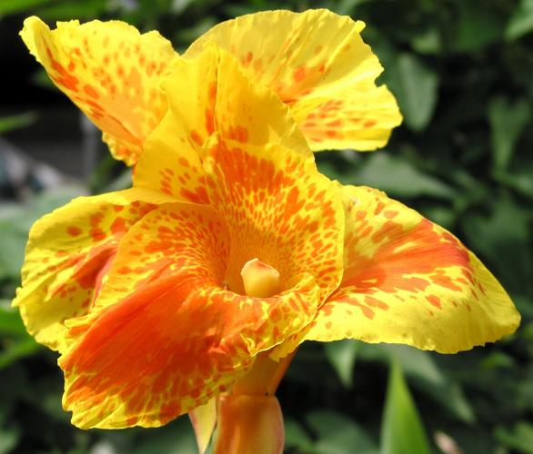
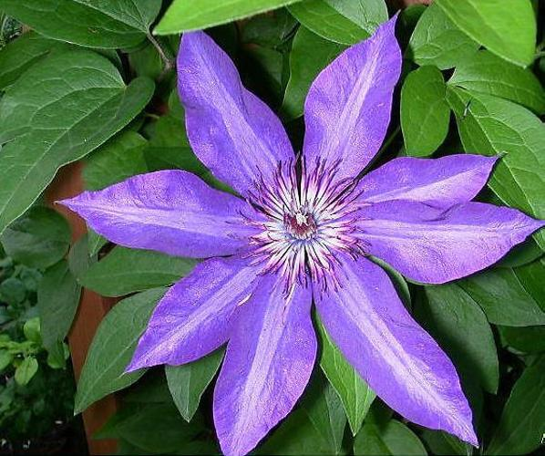
Pipeline of Selective Joint Fine-Tuning
(a) Training data in source and target domains
(b) Search K nearest neighbors in a low-level feature spaces
(c) Deep convolutional
neural network
(d) Joint training with two different label spaces
Source Training Samples in the Low-level Feature Spaces
Sea Snake
Black Grouse
Chameleon
Linear classifier
…
Dog
Barn Spider
Source Domain Loss Minimization
Source Domain Data
Fire Lily
Clematis
Rose
…
Linear classifier
Artichoke
Bee Balm
Target Training Samples in the Low-level Feature Spaces
Convolutional layers shared by the source and target learning tasks
Target Domain Data
Target Domain Loss Minimization

Slide 8
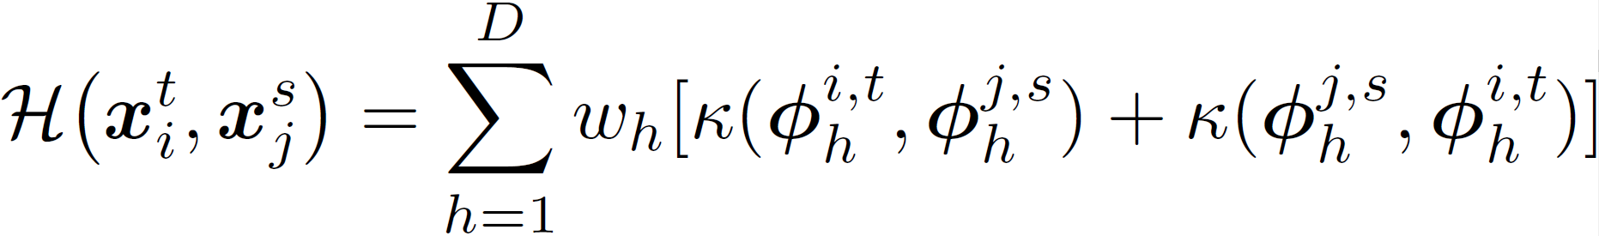
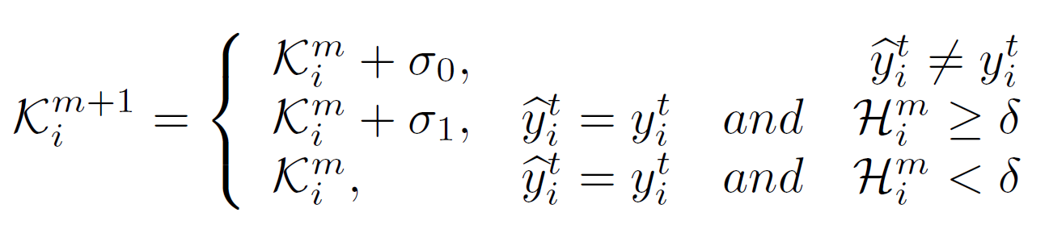
Nearest Neighbor Retrieval
Filter banks for nearest neighbor retrieval in low-level feature spaces (histograms of filter responses) from the source domain
Gabor Filter Bank:
Convolutional Filter Bank:
The first and second convolutional layers of AlexNet pre-trained on ImageNet
Rank Nearest Neighbors using JS Divergence
Increase the Number of Nearest Neighbors for Hard Samples Iteratively

Slide 9
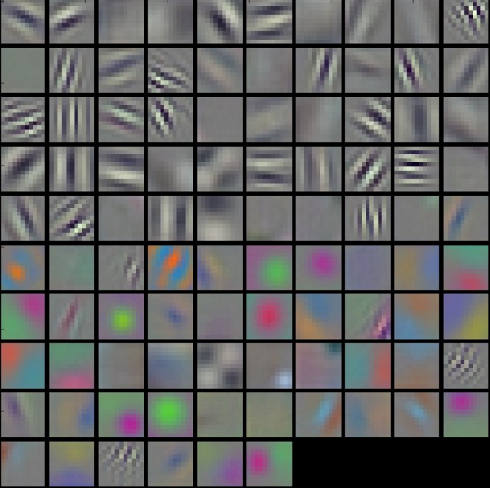
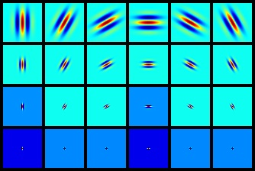
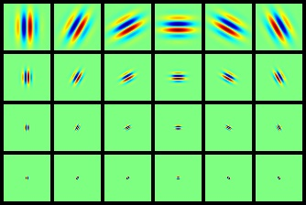
Choice of Filter Banks
Table 1. A comparison of classification performance on Oxford Flowers 102 using various choices of the filter banks in selective joint fine-tuning.
Filter Bank | Overall Accuracy(%)
Conv1-Conv2 in AlexNet | 89.59
Conv1-Conv5 in AlexNet | 88.82
Conv4-Conv5 in AlexNet | 88.48
Gabor Filters | 88.90
Fine-tuning w/o source domain | 88.12
Real Part
Imaginary Part
Filters in the First
Conv Layer of AlexNet
Gabor Filters

Slide 10
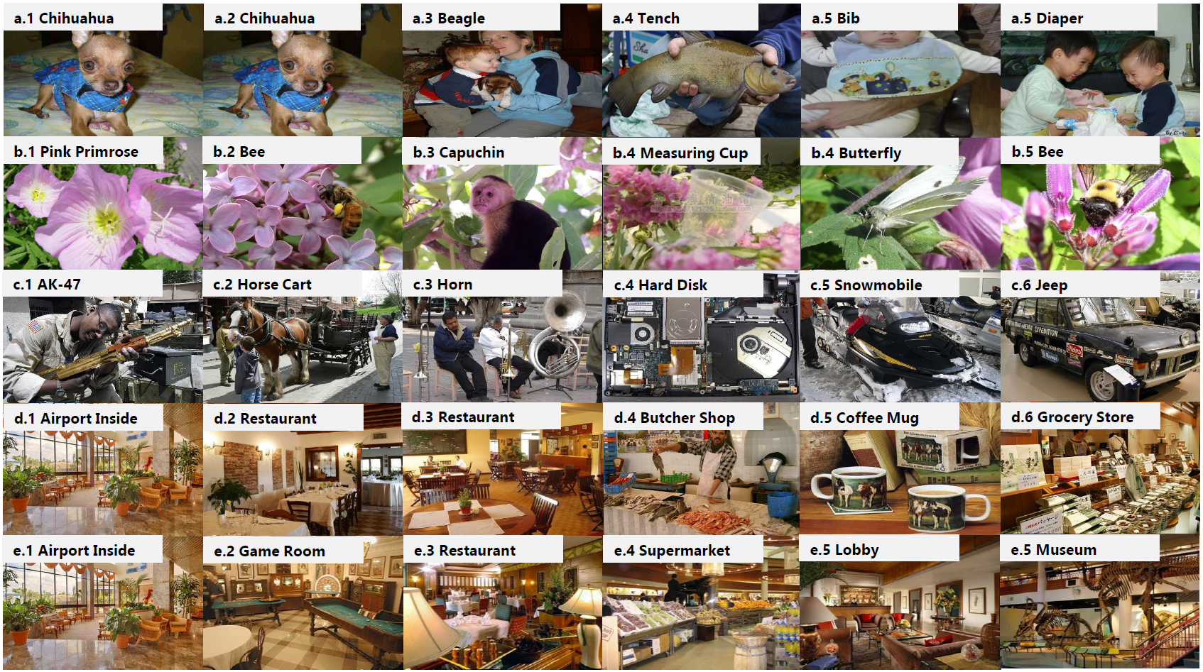
Examples of Retrieved Source Images
Target / Source
Stanford Dogs
/ ImageNet
Oxford Flowers
/ ImageNet
Caltech 256
/ ImageNet
MIT Indoor 67
/ ImageNet
MIT Indoor 67
/ Places
Target 1st NN 10th NN 20th NN 30th NN 40th NN

Slide 11
Experimental Results I
Method | mean Class Acc (%)
HAR-CNN | 49.4
Local Alignment | 57.0
Multi Scale Metric Learning | 70.3
MagNet | 75.1
Web Data + Original Data | 85.9
Training from scratch using target domain only | 53.8
Selective joint training from scratch | 83.4
Fine-tuning w/o source domain | 80.4
Joint fine-tuning with all source samples | 85.6
Selective joint FT with random source samples | 85.5
Selective joint FT w/o adaptive NN retrieval | 88.3
Selective joint FT with Gabor filter bank | 87.5
Selective joint fine-tuning | 90.2
Selective joint FT with Model Fusion | 90.3
Fine-Grained Object Recognition
A comparison of classification performance on Stanford Dogs 120.

Slide 12
Experimental Results II
Scene Classification
https://github.com/ZYYSzj/Selective-Joint-Fine-tuning
Method | mean Class Acc (%)
MetaObject-CNN | 78.9
MPP + DFSL | 80.8
VGG-19 + FV | 81.0
VGG-19 + GoogleNet | 84.7
Multi scale + multi model ensemble | 86.0
Fine-tuning w/o source domain | 81.7
Selective joint FT with ImageNet (i) | 82.8
Selective joint FT with Places (ii) | 85.8
Selective joint FT with hybrid data (iii) | 85.5
Average the output of (ii) and (iii) | 86.9
A comparison of classification performance on MIT Indoor 67.

Slide 13
Multi-Evidence Filtering and Fusion for Multi-Label Classification, Object Detection and Semantic Segmentation Based on Weakly Supervised Learning
Weifeng Ge Sibei Yang Yizhou Yu
The University of Hong Kong
Department of Computer Science

Slide 14
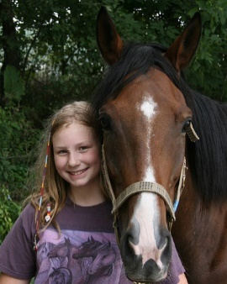
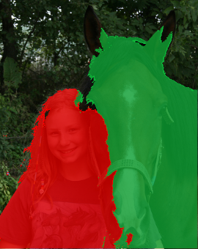
Introduction
Person, Horse
Person, Horse
0.978
Horse
0.796
Horse
Person
Person
Image Level Annotation
(a) Image Classification
(b) Object Detection
(c) Instance Segmentation
Fully Supervised
Weakly Supervised
Weakly Supervised
Notes:
Given image level labels, weakly supervised object detection and segmentation aim to locate objects and segment pixels.

Slide 15
Introduction
As only image-level labels are given, it is challenging for weakly supervised algorithms to achieve accurate object-level and pixel-level predictions.
Weakly Supervised Learning
We decompose pixel labeling in the training images into three stages, including object localization, object instance filtering and fusion, and pixel labeling with uncertainty.
With inferred pixel labels in the training images, task-specific training, such as multi-label classification, object detection and semantic segmentation can be performed in a fully supervised manner.

Slide 16
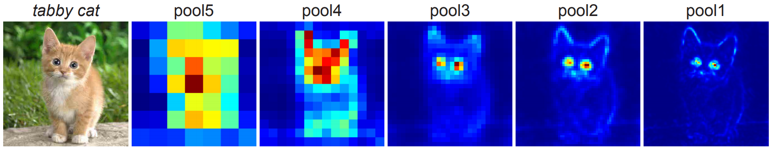
Observations
Convolutional neural networks trained using image-level label only for image classification actually act like object detectors that detect salient object parts, and then merge them to give the final predictions.

Slide 17
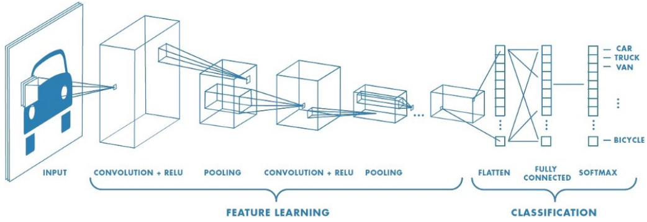
Neural Attention
Neural attention aims to find out the relationship between the pixels in the input image and the neural responses in every layer of a network. Neural attention provides a top-down mechanism to obtain pixel-wise class probabilities using image level labels only.

Slide 18
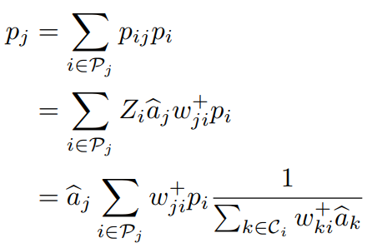
Excitation Backpropagation
Neural attention aims to find out the relationship between the pixels in the input image and the neural responses in every layer of a network. Neural attention provides a top-down mechanism to obtain pixel-wise class probabilities using image level labels only.

Slide 19
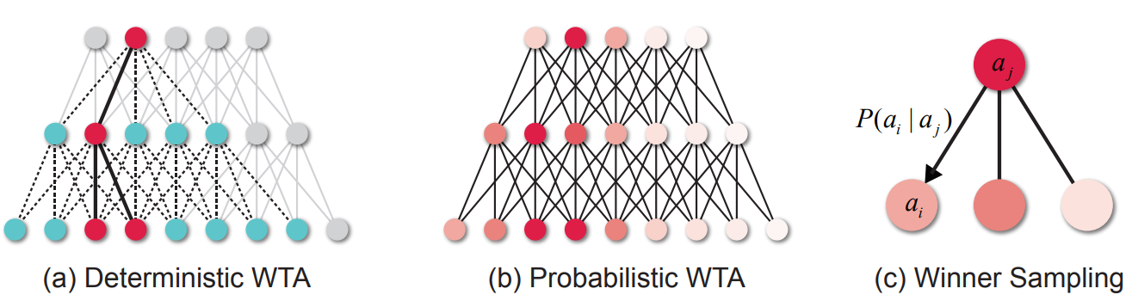
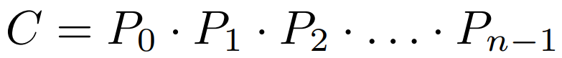
Excitation Backpropagation
Neural attention aims to find out the relationship between the pixels in the input image and the neural responses in every layer of a network. Neural attention provides a top-down mechanism to obtain pixel-wise class probabilities using image level labels only.

Slide 20
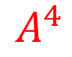

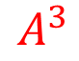
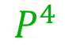

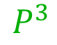
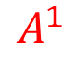
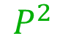

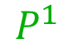
Excitation Backpropagation
Neural attention aims to find out the relationship between the pixels in the input image and the neural responses in every layer of a network. Neural attention provides a top-down mechanism to obtain pixel-wise class probabilities using image level labels only.
0
0
1
.
.
0
$$A^{4}$$
$$P^{4}$$
$$A^{3}$$
$$P^{3}$$
$$A^{2}$$
$$P^{2}$$
$$A^{1}$$
$$P^{1}$$
Excitation Backpropagation

Slide 21
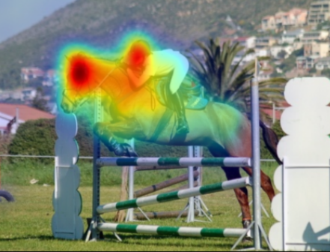
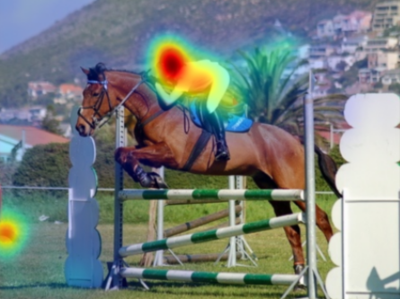
Neural Attention
Horse
Person

Slide 22
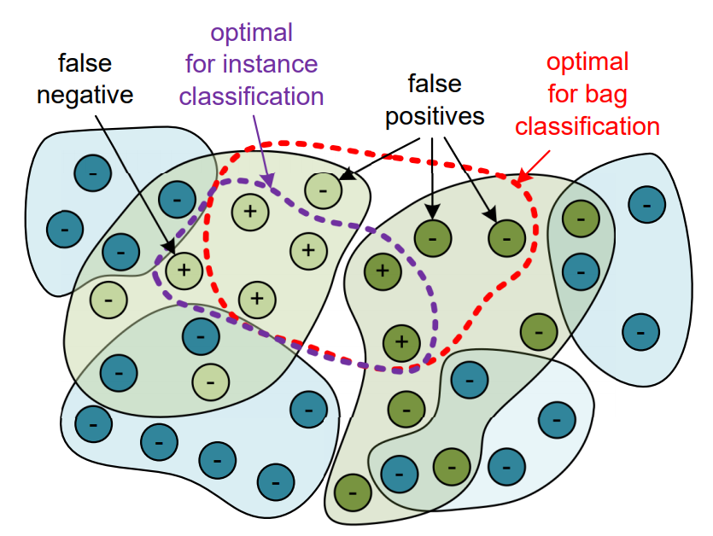
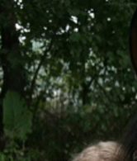
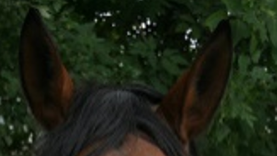
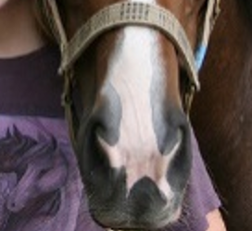
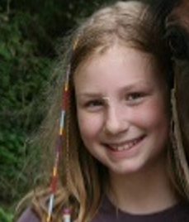
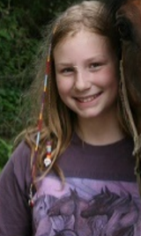
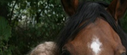
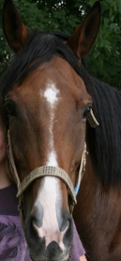
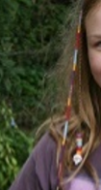
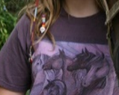
Observations
Object proposals can extract high condiment object candidates by merging image patches according their color and texture similarities unsupervised.
Multi-instance learning can find the target object hidden in multiple object candidates with the assumption that at least one object proposal contains the target object if the image has the corresponding image label.
Instances
Bag

Slide 23
Observations
Object proposals can extract high condiment object candidates by merging image patches according their color and texture similarities unsupervised.
Multi-instance learning can find the target object hidden in multiple object candidates with the assumption that at least one object proposal contains the target object if the image has the corresponding image label.
Multi-label
Classification
Proposal Weights
Label
Object Proposals Generated by Selective Search
FC
Backbone
Pool 4
ROI Pool
Conv 5
Proposal Classification
FC

Slide 24
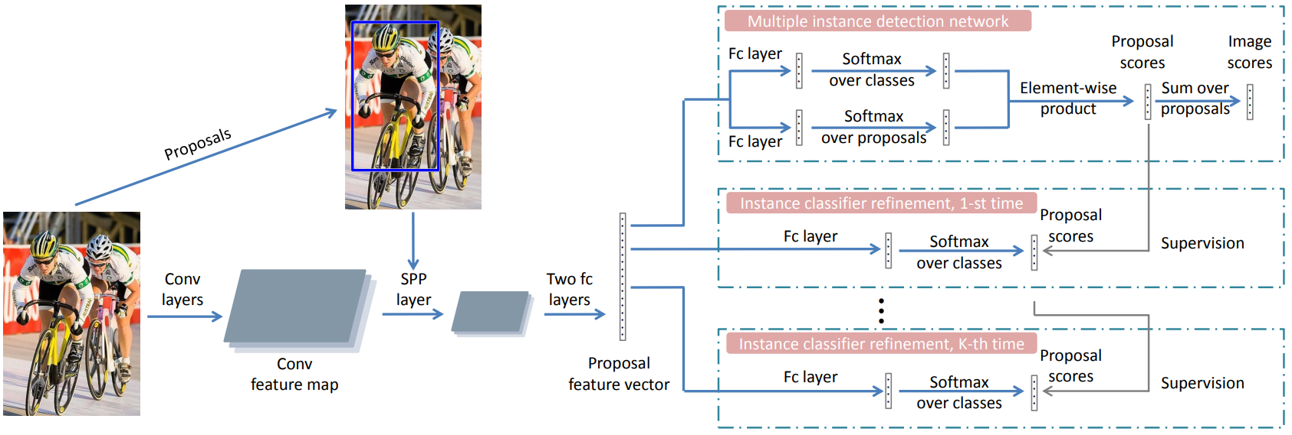
Observations
Object proposals can extract high condiment object candidates by merging image patches according their color and texture similarities unsupervised.
Multi-instance learning can find the target object hidden in multiple object candidates with the assumption that at least one object proposal contains the target object if the image has the corresponding image label.

Slide 25





















Pipeline of Multi-Evidence Filtering and Fusion
(a) Image Level Stage: Proposal Generation and Multi Evidence Fusion
(b) Instance Level Stage: Outlier Detection and Object Instance Filtering
(c) Pixel Level Stage: Probability Map Fusion and Pixel Label Prediction
Input/Image
Object Heatmap
Object Instances
Triplet Loss Net
Filtered Object Instances
Label Map with Uncertainty
$$H$$
$$ℛ$$
$$φ_{t}(∙, ∙)$$
$$ℛ^{′}$$
$${\hat{Y}}_{I}$$
Instance Attention Map
Probability Map
$$A_{l}$$
$$P$$
$$H$$
Image Attention Map
$$A_{g}$$
Instance Classifier
$$φ_{s}(∙, ∙)$$
$$A_{g}$$

Slide 26






Image Level Stage
(a) Heatmap Proposals
(b) Attention Proposals
(c) Fused Proposals

Slide 27


Instance Level Stage
(a) Input Proposals
(b) Distance Map

Slide 28








Pixel Level Stage
(a) Input/Image
(b) Object Heatmap
(c) Image Attention
(d) Instance Attention
(e) Probability
(e) Segmentation

Slide 29
Experimental Results I: Weakly Supervised Object Detection
method | aero | bike | bird | boat | bottle | bus | car | cat | chair | cow | table | dog | horse | mbike | person | plant | sheep | sofa | train | tv | mAP
OM+MIL+FRCNN | 54.5 | 47.4 | 41.3 | 20.8 | 17.7 | 51.9 | 63.5 | 46.1 | 21.8 | 57.1 | 22.1 | 34.4 | 50.5 | 61.8 | 16.2 | 29.9 | 40.7 | 15.9 | 55.3 | 40.2 | 39.5
HCP+DSD+OSSH3 | 54.2 | 52.0 | 35.2 | 25.9 | 15.0 | 59.6 | 67.9 | 58.7 | 10.1 | 67.4 | 27.3 | 37.8 | 54.8 | 67.3 | 5.1 | 19.7 | 52.6 | 43.5 | 56.9 | 62.5 | 43.7
OICR-Ens+FRCNN | 65.5 | 67.2 | 47.2 | 21.6 | 22.1 | 68.0 | 68.5 | 35.9 | 5.7 | 63.1 | 49.5 | 30.3 | 64.7 | 66.1 | 13.0 | 25.6 | 50.0 | 57.1 | 60.2 | 59.0 | 47.0
Ours+FRCNN+w/o clustering | 66.7 | 61.8 | 55.3 | 41.8 | 6.7 | 61.2 | 62.5 | 72.8 | 12.7 | 46.2 | 40.9 | 71.0 | 67.3 | 64.7 | 30.9 | 16.7 | 42.6 | 56.0 | 65.0 | 26.5 | 48.5
Ours+FRCNN+w/o uncertainty | 66.8 | 63.4 | 54.5 | 42.2 | 5.8 | 60.5 | 58.3 | 67.8 | 7.8 | 46.1 | 40.3 | 71.0 | 68.2 | 62.6 | 30.7 | 16.5 | 41.1 | 55.2 | 66.8 | 25.2 | 47.5
Ours+FRCNN+w/o instances | 67.7 | 62.9 | 53.1 | 44.4 | 11.2 | 62.4 | 58.5 | 71.2 | 8.3 | 45.7 | 41.5 | 71.0 | 68.0 | 59.2 | 30.3 | 15.0 | 42.4 | 56.0 | 67.2 | 26.8 | 48.1
Ours+FRCNN | 64.3 | 68.0 | 56.2 | 36.4 | 23.1 | 68.5 | 67.2 | 64.9 | 7.1 | 54.1 | 47.0 | 57.0 | 69.3 | 65.4 | 20.8 | 23.2 | 50.7 | 59.6 | 65.2 | 57.0 | 51.2
Average precision (in %) of weakly supervised methods on PASCAL VOC 2007 detection test set.

Slide 30
Experimental Results I: Weakly Supervised Object Detection
method | aero | bike | bird | boat | bottle | bus | car | cat | chair | cow | table | dog | horse | mbike | person | plant | sheep | sofa | train | tv | mAP
OICR-VGG16 | 81.7 | 80.4 | 48.7 | 49.5 | 32.8 | 81.7 | 85.4 | 40.1 | 40.6 | 79.5 | 35.7 | 33.7 | 60.5 | 88.8 | 21.8 | 57.9 | 76.3 | 59.9 | 75.3 | 81.4 | 60.6
WSDDN-Ens | 68.9 | 68.7 | 65.2 | 42.5 | 40.6 | 72.6 | 75.2 | 53.7 | 29.7 | 68.1 | 33.5 | 45.6 | 65.9 | 86.1 | 27.5 | 44.9 | 76.0 | 62.4 | 66.3 | 66.8 | 58.0
OM+MIL+FRCNN | 78.2 | 67.1 | 61.8 | 38.1 | 36.1 | 61.8 | 78.8 | 55.2 | 28.5 | 68.8 | 18.5 | 49.2 | 64.1 | 73.5 | 21.4 | 47.4 | 64.6 | 22.3 | 60.9 | 52.3 | 52.4
HCP+DSD+OSSH3 | 72.2 | 55.3 | 53.0 | 27.8 | 35.2 | 68.6 | 81.9 | 60.7 | 11.6 | 71.6 | 29.7 | 54.3 | 64.3 | 88.2 | 22.2 | 53.7 | 72.2 | 52.6 | 68.9 | 74.4 | 54.9
OICR-Ens+FRCNN | 85.8 | 82.7 | 62.8 | 45.2 | 43.5 | 84.8 | 87.0 | 46.8 | 15.7 | 82.2 | 51.0 | 45.6 | 83.7 | 91.2 | 22.2 | 59.7 | 75.3 | 65.1 | 76.8 | 78.1 | 64.3
Ours+FRCNN | 88.3 | 77.6 | 74.8 | 63.3 | 37.8 | 78.2 | 83.6 | 72.7 | 19.4 | 79.5 | 46.4 | 78.1 | 84.7 | 90.4 | 28.6 | 43.6 | 76.3 | 68.3 | 77.9 | 70.6 | 67.0
CorLor (in %) of weakly supervised methods on PASCAL VOC 2007 detection trainval set.

Slide 31
Experimental Results II: Weakly Supervised Object Segmentation
method | bg | aero | bike | bird | boat | bottle | bus | car | cat | chair | cow | table | dog | horse | mbike | person | plant | sheep | sofa | train | tv | m AP
SEC | 83.5 | 56.4 | 28.5 | 64.1 | 23.6 | 46.5 | 70.6 | 58.5 | 71.3 | 23.2 | 54.0 | 28.0 | 68.1 | 62.1 | 70.0 | 55.0 | 38.4 | 58.0 | 39.9 | 38.4 | 48.3 | 51.7
FCL | 85.7 | 58.8 | 30.5 | 67.6 | 24.7 | 44.7 | 74.8 | 61.8 | 73.7 | 22.9 | 57.4 | 27.5 | 71.3 | 64.8 | 72.4 | 57.3 | 37.0 | 60.4 | 42.8 | 42.2 | 40.6 | 53.7
TP-BM | 83.4 | 62.2 | 26.4 | 71.8 | 18.2 | 49.5 | 66.5 | 63.8 | 73.4 | 19.0 | 56.6 | 35.7 | 69.3 | 61.3 | 71.7 | 69.2 | 39.1 | 66.3 | 44.8 | 35.9 | 45.5 | 53.8
AE-PSL | - | - | - | - | - | - | - | - | - | - | - | - | - | - | - | - | - | - | - | - | - | 55.7
Ours+ CRF | 86.6 | 72.0 | 30.6 | 68.0 | 44.8 | 46.2 | 73.4 | 56.6 | 73.0 | 18.9 | 63.3 | 32.0 | 70.1 | 72.2 | 68.2 | 56.1 | 34.5 | 67.5 | 29.6 | 60.2 | 43.6 | 55.6
Average precision (in %) of weakly supervised methods on PASCAL VOC 2012 segmentation test set.

Slide 32














Experimental Results II: Weakly Supervised Object Segmentation
0.978
0.771
0.997
0.796
0.979
0.953
0.990
0.994
0.945
0.996
0.453
0.484
0.382
The detection and semantic segmentation results on PASCAL VOC 2012 test set.

Slide 33







Experimental Results III: Multi-Label Classification
Classification Branch
Classification Map
…
Prediction Vector
(1x1)
3x3, rate 6
Concat
3x3, rate 12
c
Input/Image
Main Net (ResNet-101)
3x3, rate 18
1x1 Conv
Image Pooling
Attention Map
Segmentation Branch

Slide 34

Experimental Results III: Multi-Label Classification
method | F1-C | P-C | R-C | F1-O | P-O | R-O | F1-C/top3 | P-C/top3 | R-C/top3 | F1-O/top3 | P-O/top3 | R-O/top3
CNN-RNN | - | 56.4 | 28.5 | 64.1 | 23.6 | 46.5 | 70.6 | 58.5 | 71.3 | 23.2 | 54.0 | 28.0
RLSD | - | 58.8 | 30.5 | 67.6 | 24.7 | 44.7 | 74.8 | 61.8 | 73.7 | 22.9 | 57.4 | 27.5
RNN-Attention | - | 62.2 | 26.4 | 71.8 | 18.2 | 49.5 | 66.5 | 63.8 | 73.4 | 19.0 | 56.6 | 35.7
ResNet101-SRN | 70.0 | 81.2 | 63.3 | 75.0 | 84.1 | 67.7 | 66.3 | 85.8 | 57.5 | 72.1 | 88.1 | 61.1
ResNet101(448$×$448)(baseline) | 72.8 | 73.8 | 72.9 | 76.3 | 77.5 | 75.1 | 69.5 | 78.3 | 63.7 | 73.1 | 83.8 | 64.9
Ours | 74.9 | 80.4 | 70.2 | 78.4 | 85.2 | 72.5 | 70.6 | 84.5 | 62.2 | 74.7 | 89.1 | 64.3
Performance comparison among multi-label classification methods on Microsoft COCO 2014 validation set.

Slide 35
Image Super-Resolution via Deterministic-Stochastic Synthesis and Local Statistical Rectification
Weifeng Ge*, Bingchen Gong*, and Yizhou Yu
The University of Hong Kong

Slide 36
Introduction
Single image super-resolution (SISR) aims to estimation high resolution images from low resolution inputs.
Image superresolution has been used for any different applications.
Facial image improvement
Compressed image/video enhancement
High dynamic range imaging
Image mosaicking
Satellite and aerial imaging
Notes:
Single image super-resolution (SISR) aims to estimate high resolution images from low resolution inputs. Image superresolution
has been used for many different applications, including facial image improvement, compressed image/video enhancement, high dynamic range imaging,
image mosaicing as well as satellite and aerial imaging.

Slide 37






Introduction
(a) Low Resolution Input
(b) Bicubic Interpolation
(c) Neural Network based Regression
(d) Details Hallucinated by GAN
(e) DTSN (Ours)
(f) Ground Truth
Notes:
Here is an example of image super resolution. It amplifies the low resolution image patch by 4 times. From left to right, the low resolution input, the result produced by Bicubic interpolation, the results generated by regression, the high frequency details generated by generative adversarial network, our method and the ground truth.

Slide 38
Core Ideas
High frequency signals in the high resolution image is irrecoverably lost in the corresponding low resolution image due to downsampling.
Many slightly different high resolution images could become the same low resolution image after downsampling.
SISR does not have a unique solution.
Treat SISR as a regression problem with the high resolution counterpart as the target does not grantee the optimal results.
Notes:
High frequency signals in the high resolution image is irrecoverably lost in the corresponding low resolution image due to downsampling.
Many slightly different high resolution images could become the same low resolution image after downsampling. Thus single image super resolution does not have a unique solution. Treat single image super resolution as a regression problem with the high resolution counterpart as the target does not grantee the optimal results.

Slide 39
Core Ideas
High frequency signals irrecoverably lost are called stochastic components.
The rest that can be recovered from the low resolution input are called deterministic components.
Notes:
In this paper, high frequency signals irrecoverably lost are called stochastic components. The rest that can be recovered from the low resolution input are called deterministic components.

Slide 40
Core Ideas
A high resolution image can be decomposed into two components, a deterministic component and a stochastic component.
The deterministic component contains all the low-frequency signals as well as part of the high-frequency signals highly correlated to the low-frequency signals, which implies that the high-frequency signals in the deterministic component could still be recovered from the low-frequency signals in a downsampled image.
The stochastic component, on the other hand, contains the rest of the signals that have little correlation with the low-frequency signals. It is the stochastic component that makes image super-resolution ill-posed.
Notes:
Therefore, a high resolution image can be decomposed into a deterministic component and a stochastic component. The deterministic component contains all the low frequency signals as well as part of the high-frequency signals. These high-frequency signals are highly correlated to the low-frequency signals. It implies that the high-frequency signals in the deterministic component could still be recovered from a downsampled image. The stochastic component, on the other hand, contains the rest of the signals that have little correlation with the low-frequency signals. It is the stochastic component that makes image super-resolution ill-posed. Then the target of single image super resolution become two folds: first, reconstruct the deterministic components as accurate as possible; second, hallucinate the stochastic component with rich details.

Slide 41
Method: High-Resolution = Deterministic + Stochastic Component

Slide 42




Method: High-Resolution = Deterministic + Stochastic Component
Deterministic Reconstruction
Reconstruction Network
Regions with dominant deterministic components: Wharf, Tree branch, …
Low-Res Input
Super-Res Output
Generative Adversarial Network
Regions with significant stochastic components: Lake, Leaf, …
Stochastic Synthesis
Notes:
The pipeline of the proposed method is shown in this figure. There are three main components: first, reconstruct the high resolution deterministic components from low resolution inputs; second, hallucinate plausible high resolution stochastic components, and these stochastic components should be compatible with the low resolution inputs; third, fuse the deterministic components and the stochastic components, and rectify the errors in the fusion results by local statistics matching.

Slide 43
Method: High-Resolution Deterministic Component Reconstruction

Slide 44










Method: High-Resolution Deterministic Component Reconstruction
(a) Low Resolution Image
(b) High-Resolution Deterministic Component Reconstruction Network
(c) Loss Function
$$ℒ_{color}$$
Mean Color Loss
1$×$1 Conv 3
Concat
LR
Conv 4
Conv 5
Generalized Gradient Loss
Conv 1
Conv 2
RDB 1
RDB 2
RDB d
RDB D
Upscale
HR
$$ℒ_{ggrad}$$
Orientation Loss
$$ℒ_{Gabor}$$
(d) Residual Dense Block
(e) Upscaling Module for $×$ 2, $×$ 3, and $×$ 4
Conv 1
Pix Shuffle 1
Conv 1
Pix Shuffle 1
Conv 1
Conv c
Pix Shuffle 1
Conv 1
ReLU
RDB d-1
ReLU
Conv C
RDB d+1
ReLU
1$×$1 Conv
Concat
Conv 2
Pix Shuffle 2
$×$ 2
$×$ 3
$×$ 4
Notes:
The figure shows the high resolution deterministic component reconstruction. We treat it as a regression problem as most deep learning based image super resolution does. Given a low resolution input, we design two novel losses to reconstruct the deterministic component. The baseline network is the best network structure in CVPR 2018. It contains basic convolution operator, many residual dense blocks, feature concatenation, element-wise sum, upscaling module and etc.

Slide 45



Method: High-Resolution Deterministic Component Reconstruction
(a) Color Loss:
(b) Generalized Gradient Loss:
(c) Orientation Loss:
(d) Final Training Loss:
Notes:
In addition to the conventional color loss, we design novel loss functions for training the above deep network. Specifically, we introduce a generalized gradient loss for better preserving local variations and an orientation loss that reconstructs local orientations. The generalized gradient loss suppresses noise while preserving gradients. The orientation loss preserves curvilinear structures, including lines and curves. Inspired by handcrafted features, such as local binary patterns (LBP), which compare pairs of nearby pixels, a generalized gradient vector at a pixel is defined as a feature vector holding pairwise differences between the center pixel and all other pixels in its r × r neighborhood. This feature is called generalized gradient because a conventional gradient for a discrete image is defined as a vector with two pairwise differences. Here we have much more pairs. We wish the generalized gradients in the reconstructed results to be as close to that in the ground truth as possible. Gabor filters are widely used in image processing because of its strong ability in texture analysis. We set up a filter every 10 degrees to accurately characterize curvilinear structures with different orientations. In addition, we adopt three different ratios between the standard deviations in the two principal directions–1 : 1, 1 : 2, and 2 : 1. The orientation loss LGabor measures the mean difference between corresponding Gabor filter responses once they have been applied to both the reconstructed result and the ground truth, and can be written as the above.

Slide 46
Compared with State-of-art in PSNR/SSIM

Slide 47

Results: High-Resolution Deterministic Component Reconstruction
Notes:
With the combination of the three losses, we improve the performance on PSNR and SSIM substantially. When compared with our baseline RDN, we get about 0.1 dB improvement on DIV2K dataset which is very impressive. We also get state-of-art results on various benchmarks, such Set5, Set14, B100, Urban100 and the DIV2K challenge at CVPR 2017.

Slide 48














Results: High-Resolution Deterministic Component Reconstruction
(a) Original
(b) Bicubic
(c) VDSR
(d) LapSRN
(e) EDSR
(f) RDN
(g) DTSN(Ours)
Notes:
Here we visualize our results to compare with the state-of-art results. From the left to right: the original input, the Bicubic interpolation, VDSR, LapSRN, RDN, and our DTSN. It can be found that the proposed losses are very powerful in recovering curvilinear structures.

Slide 49




Results: High-Resolution Deterministic Component Reconstruction
(a) $ℒ_{color}$
(b) $ℒ_{color}+α_{1}ℒ_{ggrad}$
(c) $ℒ_{color}+α_{2}ℒ_{Gabor}$
(d) $ℒ_{d}$
(e) Ground Truth
Notes:
We also perform ablation study to investigate the effects of the generalized gradient loss and the orientation loss. When we only perform the color loss which is actually the previous state-of-art RDN, it can found that different handrails are mixed with each other. When we add the generalized gradient loss only, different handrails are separated from each other. When we add the orientation loss only, the details of handrails are more clear. When we combine all of them, we get better results compared with each of them.

Slide 50
Method: High-Resolution Stochastic Component Hallucination

Slide 51

Method: High-Resolution Stochastic Component Hallucination
Generative adversarial networks (GANs) are capable of generating natural high-resolution details by exploiting a combination of color loss, perceptual loss and adversarial loss. In practice, we subtract the deterministic component from the final image generated from SRGAN to get the stochastic components.
Notes:
Generative adversarial networks (GANs) are capable of generating natural high-resolution details by exploiting a combination of color loss, perceptual loss and adversarial loss. In practice, we subtract the deterministic component from the final image generated from SRGAN to get the stochastic components. This figure shows the high resolution stochastic components.

Slide 52
Method: Structural Pixels and Non-structural Pixels

Slide 53
Method: Structural Pixels and Non-Structural Pixels
Curvilinear structures exhibit clear and spatially coherent orientations while the orientation at other pixels, including those in texture regions, is more ambiguous or spatially incoherent.
We call pixels on the curvilinear structures structural pixels, where the deterministic component plays a much more dominant role than the stochastic component.
We call pixels around the curvilinear structures non-structural pixels, where the stochastic component become much more important.
Notes:
While, before we fuse the deterministic component and the stochastic component, it is necessary to distinguish salient curvilinear structures, such as edges and contours. Curvilinear structures exhibit clear and spatially coherent orientations while the orientation at other pixels, including those in texture regions, is more ambiguous or spatially incoherent. We call pixels on the curvilinear structures structural pixels. For structural pixels, the deterministic component plays a much more dominant role than the stochastic component. We call pixels around the curvilinear structures non-structural pixels. For non-structural pixels, the stochastic component become much more important. In this way, we divide the pixels into two groups, and use them to guide the image fusion process.

Slide 54











Method: Image Structure Detection
(a) High Resolution Images
(b) Detected Curves
(c) Curve Filtering
(d) Detected Image Structures
Ground Truth Image
Detected Curves of
$$z_{k}$$
Filtered Curves
$$z$$
$${\min_{z ∈ t_{m}}\left\|z_{k}−z\right\|}^{2}$$
Deterministic Component
Detected Curves of
$z^{T}w_{m}^{t}z$ = 0
Notes:
We use ELSD to detect and vectorize curvilinear image structures, including line segments, circular arcs and elliptic arcs, by fitting relevant conic sections to detected edges. Since the deterministic component is reconstructed from a low resolution image, not all curvilinear structures in the groundtruth high resolution image belong to the deterministic component. Structural pixels are defined as pixels on the groundtruth curvilinear structures that can be reconstructed from the low resolution image. As shown in the figure, the first rows show the ground truth image and the detected curves, and the second row show in reconstructed deterministic component and the detected curves. We just aims select the edges in the constructed image that matches the corresponding on in the ground truth counterpart very well. With these filtered curves, we get the guidance for fusing the deterministic and stochastic components.

Slide 55
Method: Guided Image Fusion

Slide 56




















Results: Image Fusion and Local Statistical Rectification Network
(a) Triple Inputs
(b) Image Fusion and Local Statistical Rectification Network
(c) Local Gram Matrix Loss and Local Correlation Loss
Conv 1
Conv 2
RB 1
Conv 3
Conv 4
Deterministic
PReLU
PReLU
RB 2
PReLU
PReLU
LR
RB 3
RB 4
Conv 12
Upscale
Concat
RB 7
RB 8
RB d
RB D
PReLU
Synthesised
Conv 5
Conv 11
PReLU
Conv 6
PReLU
Stochastic
Conv 7
Conv 8
RB 5
RB 6
Conv 9
Conv 10
PReLU
PReLU
PReLU
PReLU
Conv1_1 + ReLU
Conv1_1 + ReLU
Conv1_2 + ReLU
Conv1_2 + ReLU
(f) Guided Regression Loss for Image Fusion
Pool1
Pool1
(d) Residual Block
Conv2_1 + ReLU
Conv2_1 + ReLU
$${\hat{R}}_{ij}^{2,k}$$
Conv2_2 + ReLU
$${\hat{R}}_{ij}^{2,k}$$
Conv2_2 + ReLU
RB d-1
$$ℳ$$
$$∂ℒ_{corr}^{2}$$
Pool2
Pool2
Conv 1
Conv3_1 + ReLU
Conv3_1 + ReLU
$$∂ℒ_{greg}$$
$${\hat{G}}_{ij}^{3}$$
Conv3_2 + ReLU
Conv3_2 + ReLU
PReLU
Conv3_3 + ReLU
$${\hat{G}}_{ij}^{3}$$
Conv3_3 + ReLU
Conv 1
$$∂ℒ_{gram}^{3}$$
Pool3
Pool3
PReLU
Conv4_1 + ReLU
Conv4_1 + ReLU
$${\hat{G}}_{ij}^{4}$$
Conv4_2 + ReLU
$${\hat{G}}_{ij}^{4}$$
Conv4_2 + ReLU
$$∂ℒ_{gram}^{4}$$
Conv4_3 + ReLU
Conv4_3 + ReLU
RB d+1
Notes:
We need to fuse the two complementary components generated in the previous stage to generate a single high-resolution image. In general, every pixel in the fused image should be a weighted sum of these two components. As mention before, structural pixels contain more deterministic components, and non structural pixels contain more stochastic components. We use the detected image structures to guide the image fusion process.

Slide 57

Results: Image Fusion and Local Statistical Rectification Network
(a) Guided Regression Loss:
Notes:
On the salient image structures, we only emphasize the deterministic components. On the remaining pixels, we treat the stochastic components as another important part of the regression target.

Slide 58
Method: Local Statistical Rectification

Slide 59
Results: Image Fusion and Local Statistical Rectification Network
(a) Triple Inputs
(b) Image Fusion and Local Statistical Rectification Network
(c) Local Gram Matrix Loss and Local Correlation Loss
Conv 1
Conv 2
RB 1
Conv 3
Conv 4
Deterministic
PReLU
PReLU
RB 2
PReLU
PReLU
LR
RB 3
RB 4
Conv 12
Upscale
Concat
RB 7
RB 8
RB d
RB D
PReLU
Synthesised
Conv 5
Conv 11
PReLU
Conv 6
PReLU
Stochastic
Conv 7
Conv 8
RB 5
RB 6
Conv 9
Conv 10
PReLU
PReLU
PReLU
PReLU
Conv1_1 + ReLU
Conv1_1 + ReLU
Conv1_2 + ReLU
Conv1_2 + ReLU
(f) Guided Regression Loss for Image Fusion
Pool1
Pool1
(d) Residual Block
Conv2_1 + ReLU
Conv2_1 + ReLU
$${\hat{R}}_{ij}^{2,k}$$
Conv2_2 + ReLU
$${\hat{R}}_{ij}^{2,k}$$
Conv2_2 + ReLU
RB d-1
$$ℳ$$
$$∂ℒ_{corr}^{2}$$
Pool2
Pool2
Conv 1
Conv3_1 + ReLU
Conv3_1 + ReLU
$$∂ℒ_{greg}$$
$${\hat{G}}_{ij}^{3}$$
Conv3_2 + ReLU
Conv3_2 + ReLU
PReLU
Conv3_3 + ReLU
$${\hat{G}}_{ij}^{3}$$
Conv3_3 + ReLU
Conv 1
$$∂ℒ_{gram}^{3}$$
Pool3
Pool3
PReLU
Conv4_1 + ReLU
Conv4_1 + ReLU
$${\hat{G}}_{ij}^{4}$$
Conv4_2 + ReLU
$${\hat{G}}_{ij}^{4}$$
Conv4_2 + ReLU
$$∂ℒ_{gram}^{4}$$
Conv4_3 + ReLU
Conv4_3 + ReLU
RB d+1
Notes:
We need to fuse the two complementary components generated in the previous stage to generate a single high-resolution image. In general, every pixel in the fused image should be a weighted sum of these two components. As mention before, structural pixels contain more deterministic components, and non structural pixels contain more stochastic components. We use the detected image structures to guide the image fusion process.

Slide 60






Results: Image Fusion and Local Statistical Rectification Network
(a) Local Gram Matrix Loss:
(b) Local Correlation Matrix Loss:
(c) Combined Loss:
Notes:
For a location in the convolutional feature map, in its neighborhood, we calculate a local Gram matrix Gl (m,n). The difference from the one used in image style transfer is that the Gram matrix is computed for a square window centered at the location instead of over the entire feature map. Here we also incorporate spatial correlation matrixes to describe the stochastic component over local regions. Both the local Gram matrix loss and the local correlation matrix loss aim to match the local statistics on the feature map of the fusion results to that of the ground truth. Note that the matching process is performed on each feature location.

Slide 61
Results: Visual Comparison with State-of-art Results

Slide 62



















Results: Image Fusion and Local Statistical Rectification Network
(a) Deterministic Component
(b) Stochastic Component
(c) Image Structures
(d) Image Fusion
(e) Statistical Rectification
(f) Ground Truth
Notes:
The figure shows the results of different stages. The results of the deterministic reconstruction is blurred. The stochastic component hallucination results contain much more details but also take in unpleasant chaos in image structures. In the detected image structures, we find that it focuses on salient curves and line segments. After image fusion, we get clear image structures and more high frequency details. When we perform local statistical rectification, we get better results which contain much more fine details.

Slide 63















Results: Image Fusion and Local Statistical Rectification Network
Bicubic
RDN
SRGAN
Ours
Ground Truth
Notes:
Here we compare with state-of-art results visually. It can be found that RDN can not produce high frequency details. SRGAN destroys image structures heavily. The proposed method can produce enough fine high frequency details and the correct image structures at the same time.

Slide 64
Results: Image Fusion and Local Statistical Rectification Network
RDN
SRGAN
DTSN (Ours)
Ground Truth
Notes:
Here is more visual comparison results. You can see that RDN does not give enough details. SRGAN produce many noise along the curves. While DTSN gets very competitive results even compared with the ground truth.

Slide 65






Results: Image Fusion and Local Statistical Rectification Network
DTSN (Ours)
SRGAN
RDN
EDSR
LapSRN
Bicubic
Notes:
We put more results in the supplementary material.

Slide 66
Limitations

Slide 67
Limitations:
The performance heavily relies on the accuracy of the structure detection algorithm. ELSD can only detect line segments, circular and elliptical arcs.
The local Gram matrix loss may cause halos/ringing around certain strong edges.
The hallucinated details during local statistical rectification are too strong in certain images.
Notes:
There are also some obvious limitations of our algorithm. The performance heavily relies on the accuracy of the structure detection algorithm. ELSD can only detect line segments, circular and elliptical arcs. The local Gram matrix loss may cause halos/ringing around certain strong edges. The hallucinated details during local statistical rectification are too strong in certain images.

Slide 68
Thank you!
- Q&A

